Slide 1
Research & Ethics
Introduction

Slide 2


Slide 3
Unethical Research Pt. 1

Slide 4
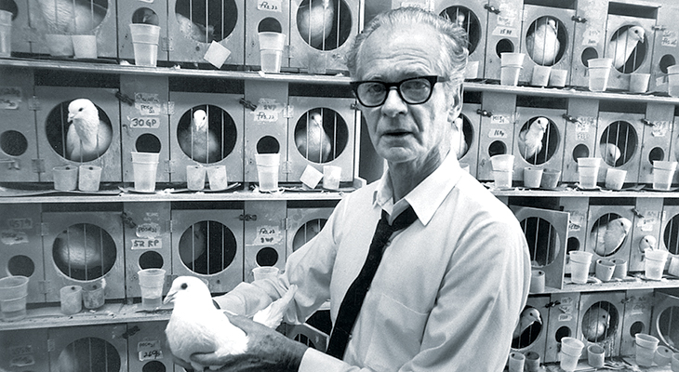
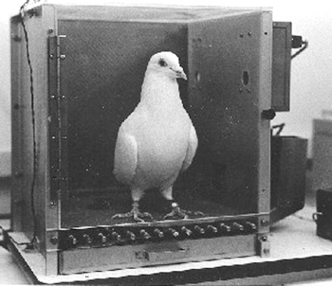
B. F. Skinner
Operant conditioning
GFA, n.d. Skinner and Behaviorism. In: Harvard University Brain Tour [viewed 6 October 2019]. Available from: https://braintour.harvard.edu/archives/portfolio-items/skinner-and-behaviorism

Slide 5
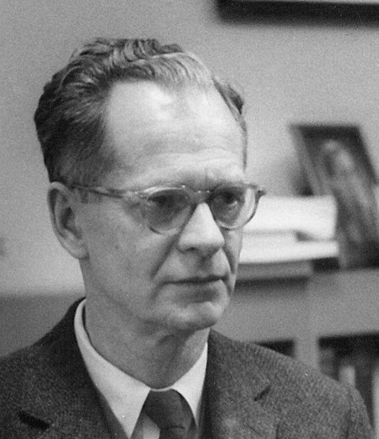
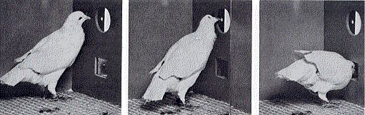
B. F. Skinner
Operant conditioning
The Skinner Box
SKINNER, B., 1992. ‘Superstition’ in the pigeon. Journal of Experimental Psychology: General, 121(3)
(This article is a reprint of an original work published in 1948 in the Journal of Experimental Psychology, 38, 168- 172.)
John Watson
https://www.simplypsychology.org/operant-conditioning.html
https://www.simplypsychology.org/classical-conditioning.html
Notes:
Operant conditioning is a method of learning that occurs through rewards and punishments for behavior. Through operant conditioning, an individual makes an association between a particular behavior and a consequence (Skinner, 1938).

Slide 6
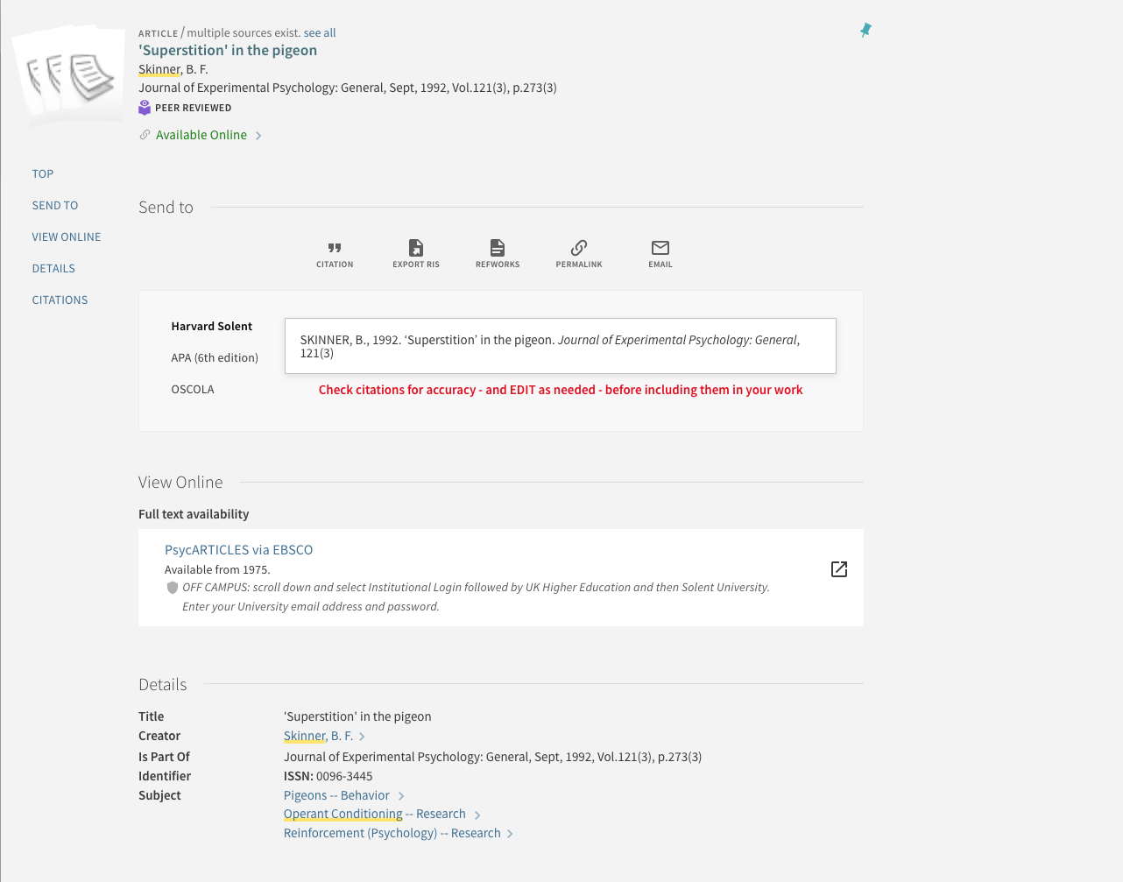
https://catalogue.solent.ac.uk/discovery/fulldisplay?docid=gale_hrca12940239&context=PC&vid=44SSU_INST:VU1&search_scope=MyInst_and_CI&tab=Combined&lang=en

Slide 7

Stroszek, 1977. Directed by Werner HERZOG. Leipzig: Werner Herzog Filmproduktion

Slide 8
Unethical Research Pt. 2

Slide 9

PRISONEXP.ORG., 2019. Stanford Prison Experiment [viewed 6 October 2019]. Available from: https://www.prisonexp.org

Slide 10

The Stanford Prison Experiment 1973
Purpose of the Study “Zimbardo and his colleagues were interested in finding out whether the brutality reported among guards in American prisons was due to the sadistic personalities of the guards (i.e., dispositional) or had more to do with the prison environment (i.e., situational).”
MCLEOD. S., 2019. Stanford Prison Experiment | Simply Psychology [viewed 6 October 2019]. Available from: https://www.simplypsychology.org/zimbardo.html

Slide 11

https://youtu.be/sYtX2sEaeFE
Zimbardo Stanford Prison Experiment 1 1, n.d. [film] [viewed 6 October 2019]. Available from: https://www.youtube.com/watch?v=hIUlBrvqyyo

Slide 12
Conclusion
“Zimbardo's Stanford prison experiment revealed how people will readily conform to the social roles they are expected to play, especially if the roles are as strongly stereotyped as those of the prison guards.”
PRISONEXP.ORG., 2019. Stanford Prison Experiment [viewed 6 October 2019]. Available from: https://www.prisonexp.org

Slide 13
Unethical Research Pt. 3

Slide 14
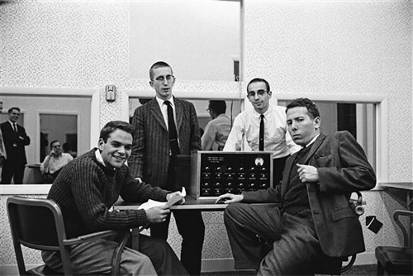
Behavioural Study of Obedience

Slide 15
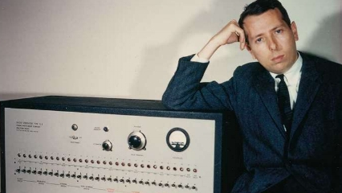
Stanley Milgram (1933-1984) was an American social psychologist. He was best known for his controversial experiment on obedience, which was conducted in the 1960s.
MILGRAM, S., 1963. APA PsycNet Available from: https://psycnet.apa.org/record/1964-03472-001

Slide 16
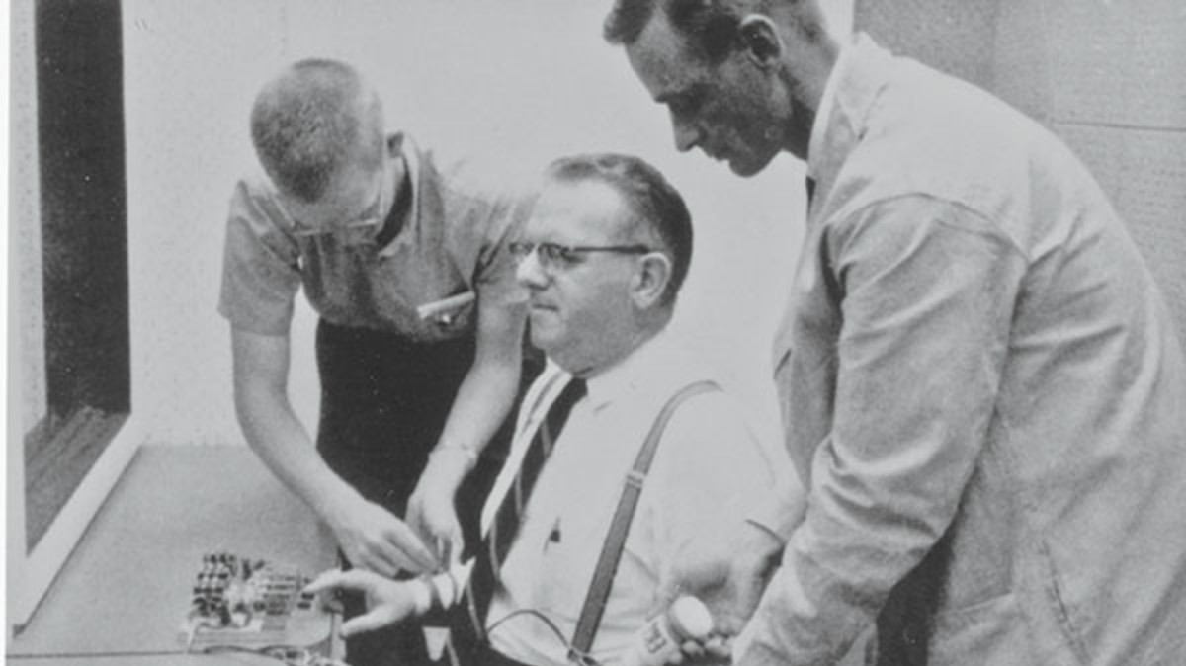
Behavioural Study of Obedience

Slide 17
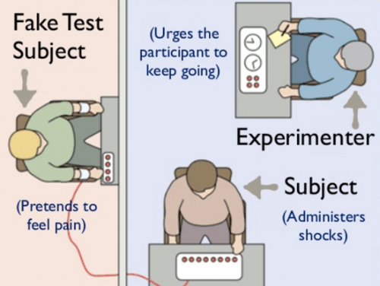
MODERNTHERAPY, 2018. Milgram’s Experiments Explained [viewed 3 July 2023]. Available from: https://moderntherapy.online/blog-2/millgrams-experiments-explained

Slide 18
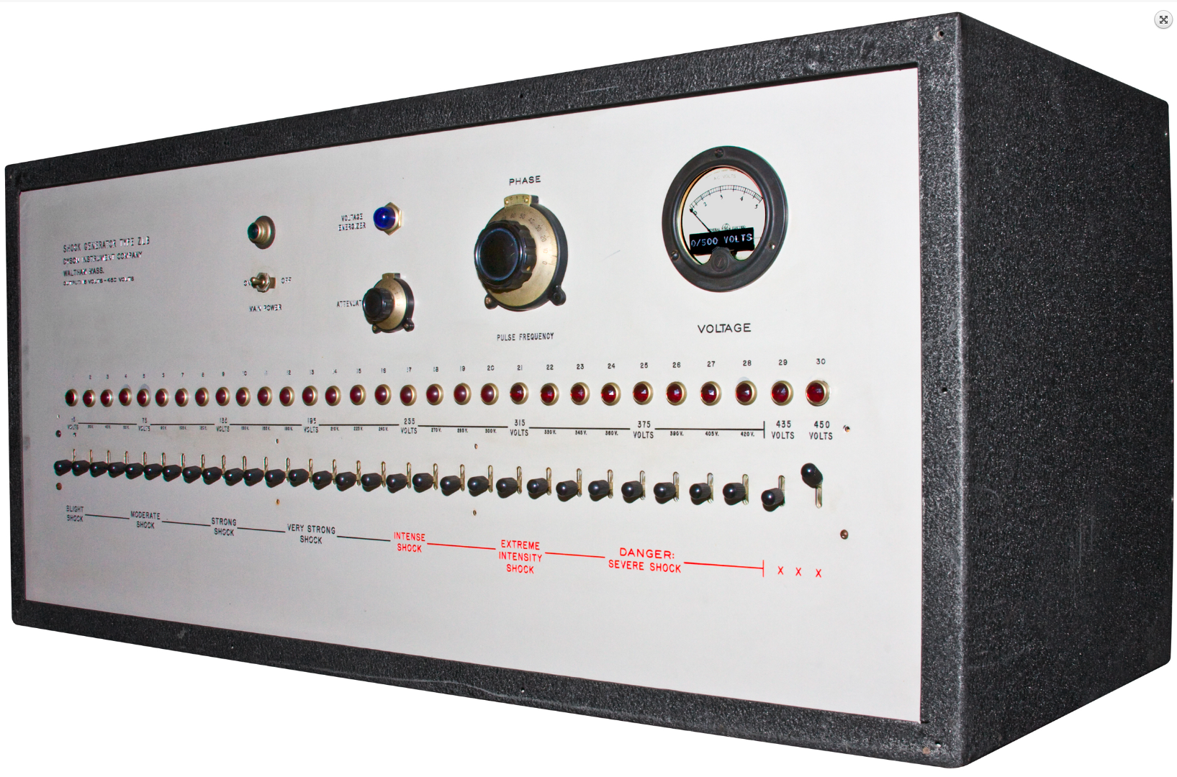

Slide 19
Ethical Policies

Slide 20
Ethics - “Do No Harm”
All staff and students have a responsibility to ensure, as far as possible, the physical, social, and psychological well-being of those involved in any teaching, research, and innovation they carry out. In doing so, they should aim to anticipate and guard against potentially harmful consequences wherever possible.

Slide 21
In addition, all research and innovation must comply with the UK legislation concerning, for example, Human Rights; General Data Protection Regulation and other Data Protection Laws; Freedom of Information; Obscenity, and Public Decency (this is not an exhaustive list). Where standing/specialist panels and the University Research Ethics and Integrity Committee wish to seek advice in this regard, they should, in the first instance, contact the Clerk to the Governors and the University’s Legal Officer.
SOLENT UNIVERSITY, 2022. University Ethics Policy. [viewed 28 June 2023) https://students.solent.ac.uk/official-documents/quality-management/academic-handbook/2s-solent-university-ethics-policy.pdf

Slide 22
Informed Consent

Slide 23
Informed Consent
All participants in your project should give their consent before any data is collected from them. Consent should normally be sought from any participant in advance of their participation
A key part of gaining consent is that ensuring the participant is fully informed about the reason for the study. This means that there should be arrangements in place for explaining the evaluation. This may be in the form of an introductory information.
Academic Handbook Section 2S (2022)

Slide 24
Explain why the evaluation is taking place
Outlines its key aims and objectives
Assure the respondent of confidentiality and anonymity
Explain how the information will be used
Explain how the respondents can receive information about the findings
Explain how the respondent can find out more information on the study
Thank the respondent.

Slide 25
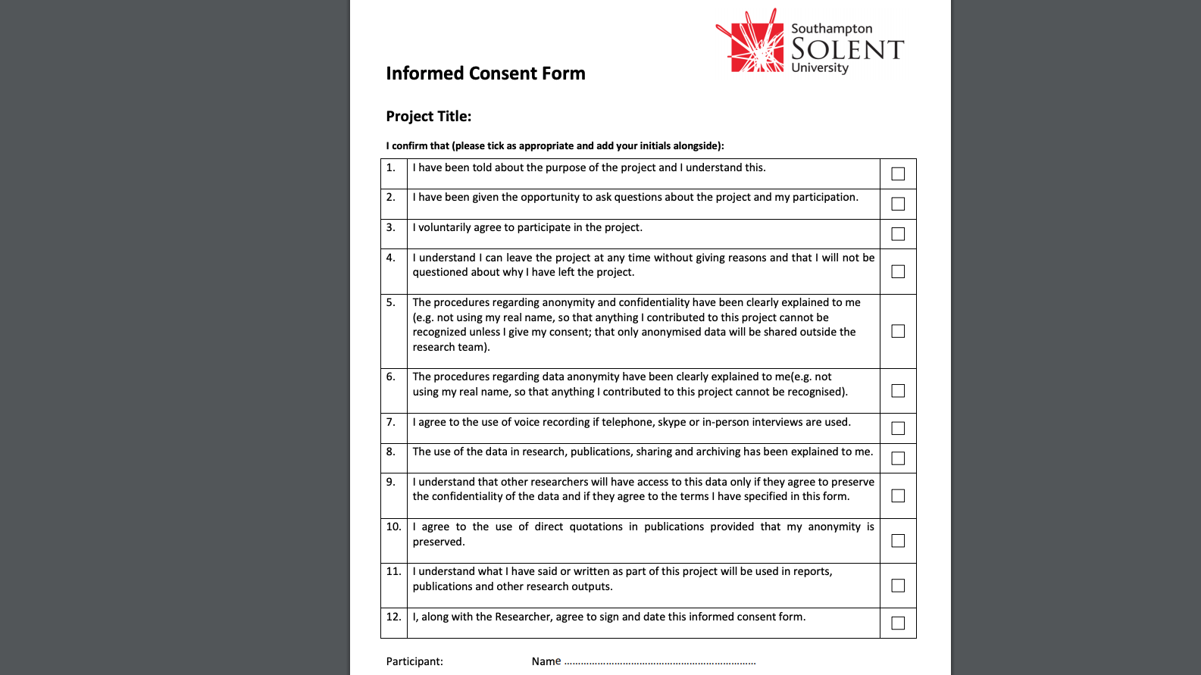

Slide 26
When undertaking research, it is important to consider implications for data protection. Please read the University's information on the General Data Protection Regulation (GDPR)

Slide 27
Ethical Release

Slide 28
ALL STUDENTS MUST OBTAIN ETHICAL CLEARANCE FOR THEIR PROJECT
All projects must be carried out within the framework of the University’s Ethics Policy, see the portal for full details. An ethics release form should be completed as soon as your project has been approved. This can be done online via the Portal Apps.
Information for students
2S: Solent University Research Ethics and Integrity Policy
Ethics Projects App

Slide 29
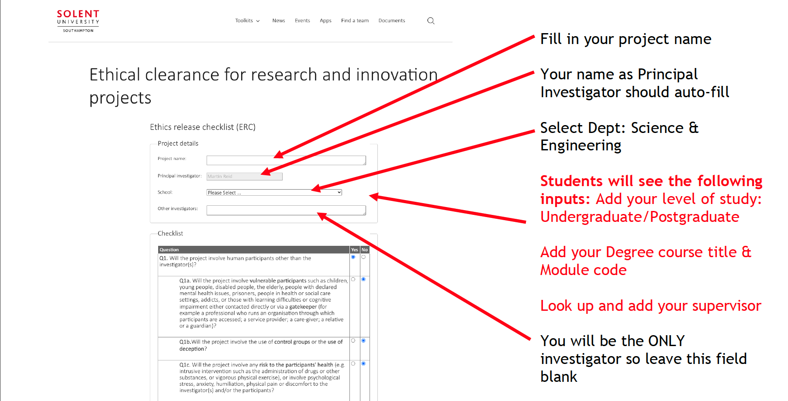

Slide 30
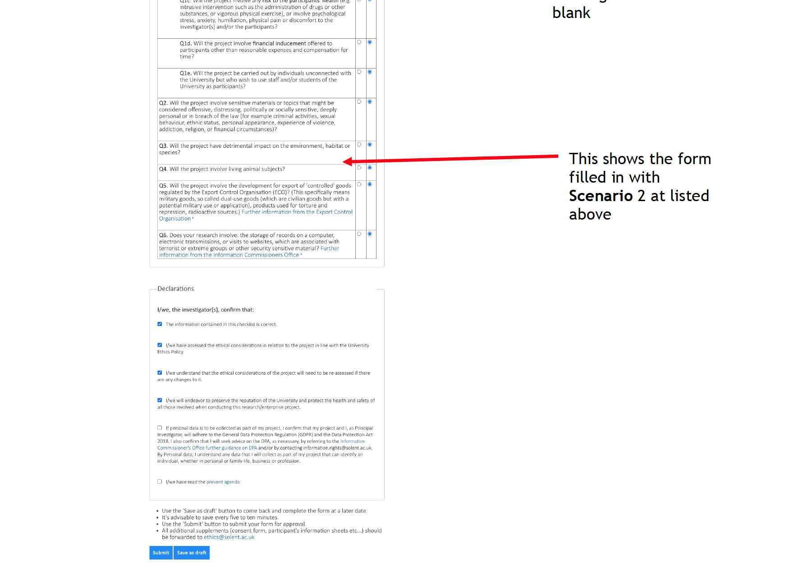

Slide 31
Survey Data Collection

Slide 32

Data collection & online survey tools
Staff and students wishing to complete data collection via online surveys must use the University's licence for Jisc Online Surveys. If you do not have an user, you can email research.innovation@solent.ac.uk to request one or your tutor can get an invite link sent to a cohort of students.
onlinesurveys.ac.uk

Slide 33
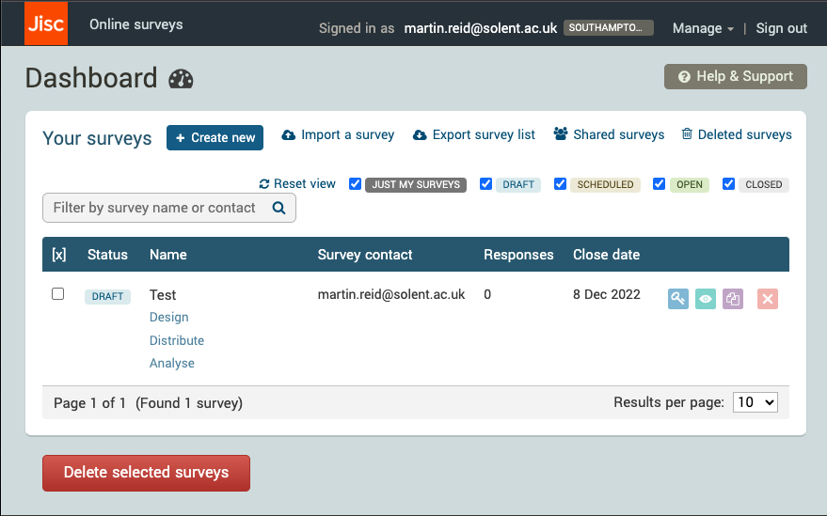
onlinesurveys.ac.uk

Slide 34
Do not use any of the survey platform such as survey monkey etc. for your research
It will be considered a breach of ethical regulations if any other survey tool is used.

